Slide 1
Queen Slaying
or how I approached CSE 271 Project 2

Slide 2
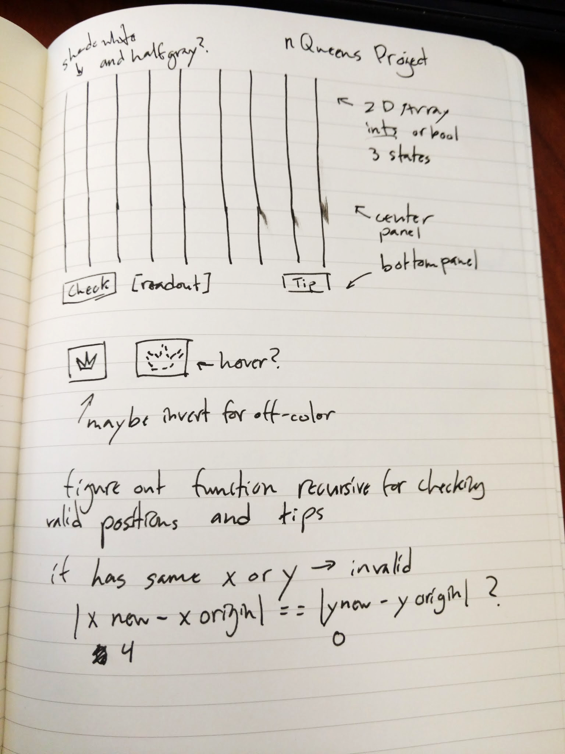
Drawing some skeletons first
Drew a prototype of the UI first
Made sure to label what panels were where
Already started thinking about what data type to track Queens, Tips and invalid positions
Sketched a button icon

Slide 3
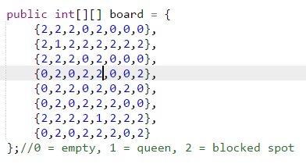
Coming at it from the back
ChessBoard.java
ChessFrame.java
Wanted to tackle the hardest part first (checking board and tips)
Made 2D int array to represent board in separate ChessBoard class
Made it easy to see data quickly and test methods without added complication of GUI
Tips are found from remaining 0s in int array after checking board
Notes:
Coordinates had to be flipped a lot because the array lists things as the Y value first then X.

Slide 4
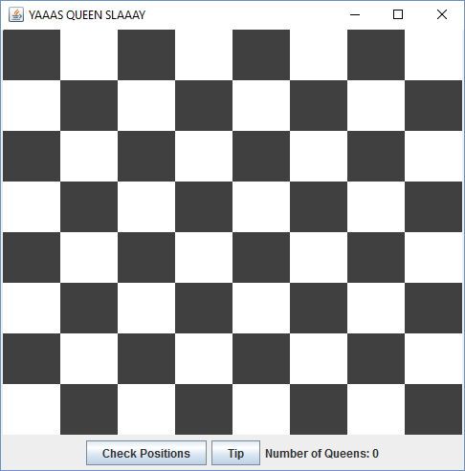
Smashing the front end
ChessFrame.java
Constructed plain GUI from notes
Would have been easier to make custom Queen Buttons and interpret data directly in frame class
Instead had to track data between classes and update GUI constantly
Waited until everything was working to add fancy bits

Slide 5
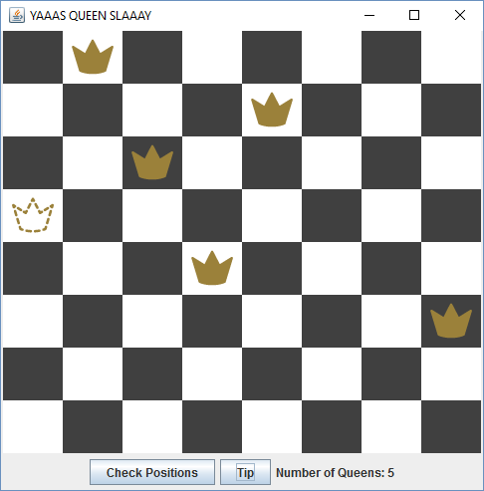

Funny bits and weird buttons
Board
Icons
Placed Queen
Placement Tip
Invalid/Dead Queen
Notes:
Buttons had to be set opaque and disable painted borders in order for background colors to show up. Chose colors for the icons that would show up nicely on white and dark gray.

